Slide 1

Introduction to Computer Systems
Operating Systems 1
Direct Link to view these slides on Google Docs

Slide 2
What to expect in this topic:
What programs and hardware are in a computer?
What does an operating system do?
Resource management
Memory access times vs typical capacity
How do input/output devices communicate with computer systems
Disk scheduling

Slide 3
A Computer
Operating System
CPU
RAM
Monitor
OS
Flash Memory
Keyboard
Printer
Disk CD/DVD
Mouse

Slide 4
A Computer
Application Programs
Web Browser | PowerPoint | Games
Compilers | Editors | Command Interpreter
System Programs
Operating System
Machine Language
Microarchitecture
Hardware
Physical Devices

Slide 5
What does a OS do?
Booting: Booting is a process of starting the computer operating system starts the computer to work. ...
Memory Management.
Loading and Execution.
Data security.
Disk Management.
Process Management.
Device Controlling.
Printing controlling.
1) extending the computer;
2) managing resources.

Slide 6
Extending the Computer
A hard drive example:
surface 3
surface 2
surface 1
surface 0

Slide 7
Animated: Extending the Computer
sector
cylinder
track
heads
For more information on how hard drives work - please visit https://www.youtube.com/watch?v=NtPc0jI21i0 and https://www.youtube.com/watch?v=wteUW2sL7bc

Slide 8

Extending the Computer
read & write: 13 parameters in 9 bytes
1) address of the disk;
2) number of surface;
3) number of cylinder;
4) number of track;
5) kind of recording mode
(continuous, interleaf, ...);
6) what to do if the data is not found;
7) ...
heads
is the motor on? is the motor off?
JUST GIVE ME A READ & WRITE INSTRUCTION
(that is an extended or virtual computer)

Slide 9
Resource Manager
- manages all of the parts of complex systems
- manages more than one program (eg. programs requesting to print at the same time, or different programs requesting to use the same file;
Time & space multiplexing (sharing)
Fair distribution of resource (CPU, …)
RAM

Slide 10
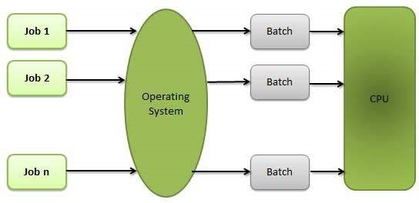
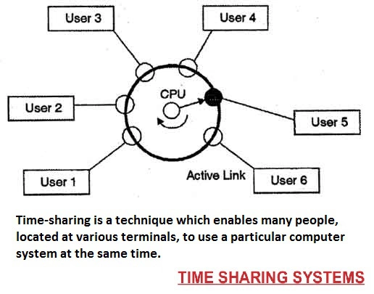
Different Operating Systems
Offers 3 kinds of services:
batch
transaction processing
timesharing
Mainframes OS
Server OS
Multiprocessor OS
Personal computer OS
Real-time OS
Embedded OS
Smart card OS

Slide 11
Computer hardware review
How does a computer system connect together, talk to other hardware and store information?
By using:
CPUs
Memory
I/O devices
Buses

Slide 12
Memory Hierarchy
typical access time
typical capacity
1 nsec
registers
< 1 KB
2 nsec
cache
1 MB
10 nsec
RAM
64-512 MB
10 msec
magnetic disks
5-50 GB
100 sec
magnetic tape
20-100 GB

Slide 13
Memory - RAM
Different programs in RAM means to:
1) protect programs from one-another and the kernel from them all;
2) how to handle relocation.

Slide 14
Memory - MMU: Memory Management Unit
Closely in conjunction with the CPU, the MMU maps virtual to physical mapping, allowing lookup. This stores the indexes in which the page table is stored.
0xFFFFFFFF
limit-2
user-2 data
base-2
user program and data
limit-1
base-1
user-1 data
limit-0
limit
user program and data
limit-0
user program
base
base-0
base-0
OS
OS
0
For further information, please visit the Using a Memory Manager video: https://www.youtube.com/watch?v=IyRNk5SMEpM

Slide 15
I/O (Input/ Output) Devices
device:
monitor RAM disk (IDE disk)
hardware
controller:
video card
multiple chips
chip
device drive:
(reboot the system, plug & play)
software
OS
IDE: Integrated Drive Electronics

Slide 16
I/O Devices
Every controller has a small number of registers.
1) On some computers these registers are mapped into the OS’s address space, so that they can be read and written as ordinary memory words. On such computers no special I/O instructions are needed and user programs can be kept away from the hardware by not putting these memory addresses within their reach (that is, using base and limit registers).
This scheme eliminates the need for special I/O instructions but uses some of the address space.
2) On other computers these registers are put in a special I/O port space, with each register having a port address. On these machines special IN and OUT instructions are needed/available in kernel mode to allow drivers to read and write the registers.
This scheme uses no address space but requires special instructions.

Slide 17
I/O Scheduling
Physical devices much slower than electronics
Multiple I/O requests may be outstanding at any time
OS can reorder requests to improve response
Disk response time
Seek time – moving to correct track
Rotational latency – waiting for correct sector to reach read/write heads
Transfer time – actually reading or writing data
Seek is mechanical movement
SLOW
For more information, please read Tanenbaum. (2006). Structured computer organization / by Andrew S. Tanenbaum. (5th ed.). Pearson Prentice Hall. pp. 383 - 386

Slide 18
Disk Scheduling
Order outstanding disk requests to minimise seek times
FCFS – first come first served – order of arrival of requests
SSTF – shortest seek time first – choose request on nearest track
SCAN – keep moving head in same direction until no more requests

Slide 19
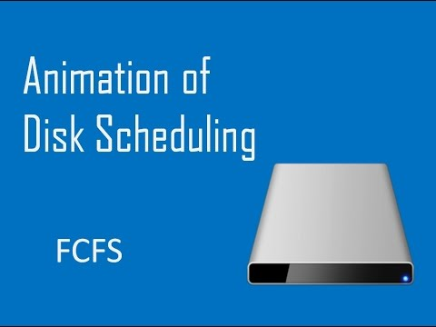
Disk Scheduling - FCFS Example
Order outstanding disk requests to minimise seek times
FCFS – first come first served – order of arrival of requests
SSTF – shortest seek time first – choose request on nearest track
SCAN – keep moving head in same direction until no more requests
FCFS Example:
Assume at track 53
Requests for 98, 183, 37, 122, 14, 124, 65, 67
FCFS visits them in that order
Total no of tracks traversed
640

Slide 20
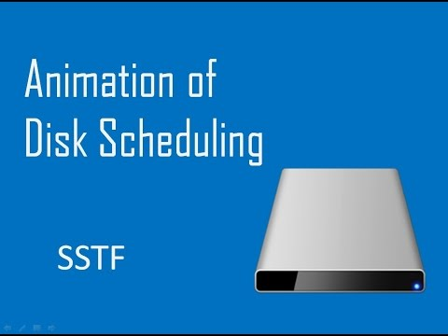
Disk Scheduling - SSTF Example
Order outstanding disk requests to minimise seek times
FCFS – first come first served – order of arrival of requests
SSTF – shortest seek time first – choose request on nearest track
SCAN – keep moving head in same direction until no more requests
SSTF Example:
Assume at track 53
Requests for 98, 183, 37, 122, 14, 124, 65, 67
SSTF visits them in this order 53, 65, 67, 37, 14, 98, 122, 124, 183
Total no of tracks traversed
236

Slide 21
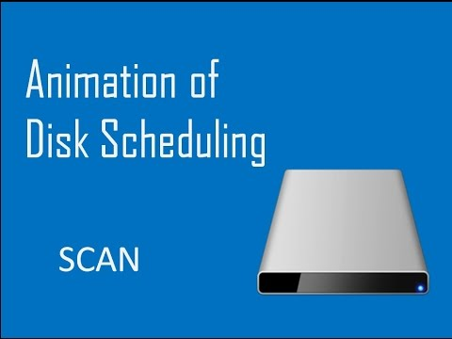
Disk Scheduling - Scan Example
Order outstanding disk requests to minimise seek times
FCFS – first come first served – order of arrival of requests
SSTF – shortest seek time first – choose request on nearest track
SCAN – keep moving head in same direction until no more requests
SCAN Example:
Assume at track 53
Requests for 98, 183, 37, 122, 14, 124, 65, 67
SCAN visits them in the order 53, 37, 14, 0, 65, 67, 98, 122, 124, 183 (the initial direction depends on where the head was previously this example assumes previous track higher than 53 and hence was moving in a backward direction)
Total no of tracks traversed
236
(Tutorial on Disk Scanning Algorithms - We have looked at the first 3 algorithms only)

Slide 22
I/O Scheduling Overview
cache bus
local bus
memory bus
level 2 cache
PCI bridge
CPU
RAM
PCI bus
IDE bus
SCSI
USB
graphic adaptor
ISA bridge
IDE disk
USB bus
available slots
SCSI bus
mouse
keyboard
monitor
ISA bus
modem
sound card
printer
ISA: Industry Standard Architecture
USB: Universal Serial Bus
PCI: Peripheral Component Interconnect
SCSI: Small Computer System Interface
IDE: Integrated Drive Electronics

Slide 23
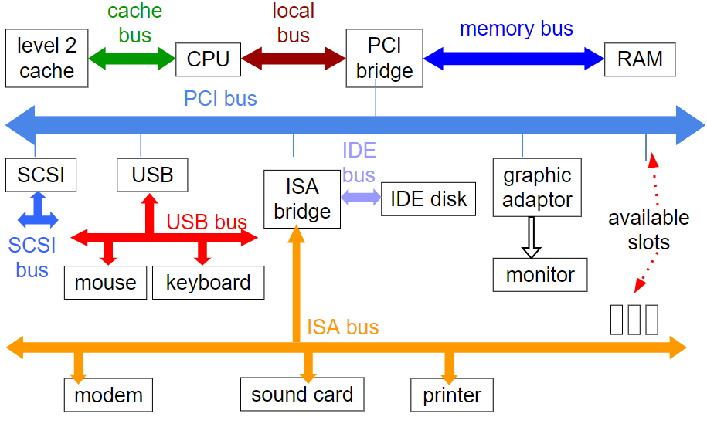
Buses
Definitions:
PCI: Peripherals Component Interconnect
SCSI: Small Computer System Interface
USB: Universal Serial Bus
IDE: Integrated Drive Electronics
ISA: Industry Standard Architecture
The OS has to know the details of each bus and configure it.
Each bus uses a different interrupt number, registers, memory locations etc.

Slide 24
Operating Systems Summary
Computer can be split up into hardware, system programs and application programs
An OS extends a computer and manages its resources
Resource managers control complex systems, vying for resources and RAM
I/O devices use buses to communicate with the rest of the hardware using interrupt numbers, registers and memory locations

